Slide 1

Customer Segmentation
Team – Data Warriors
Jahnavi Bollimuntha
Shivani Nagamandla
Viswanth Tammana
Dharani Thakkallapally

Slide 2
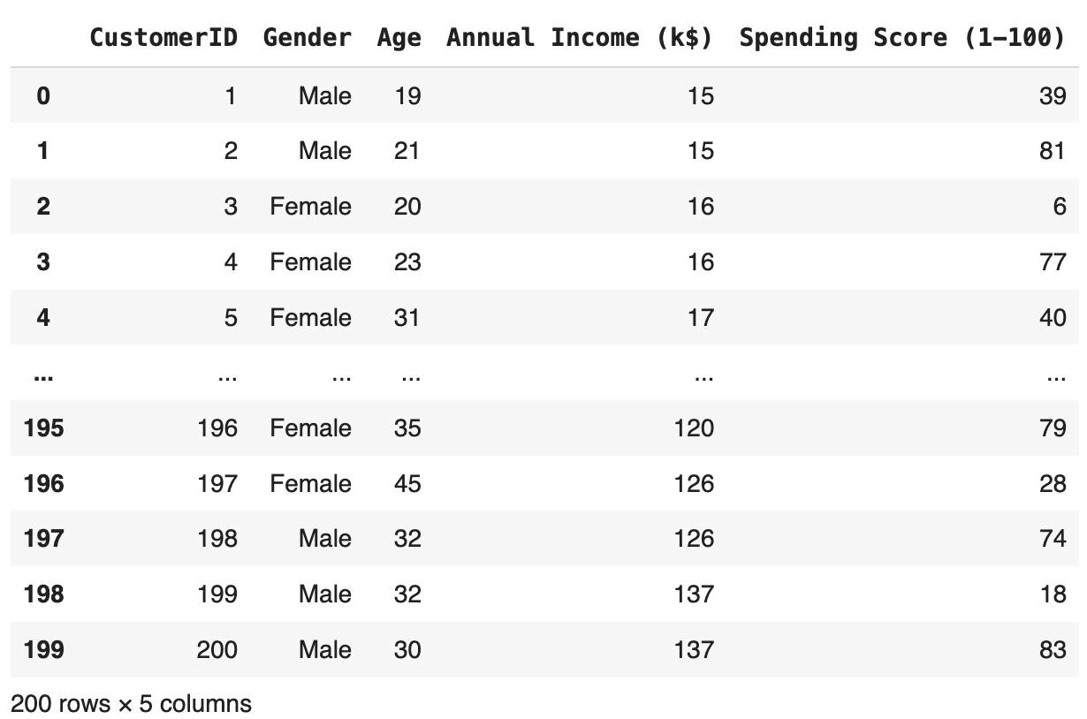
Dataset
Customer ID: ID of the customers
Gender: Gender (M or F)
Age: Age of the customers
Annual Income: Annual Income of the customers
Spending Score: How often a person spends money in a mall on a scale of 1 to 100

Slide 3
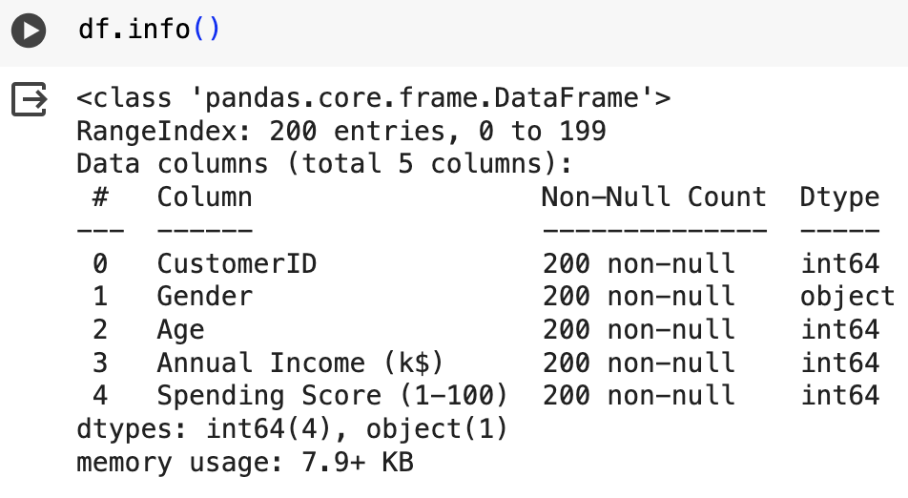
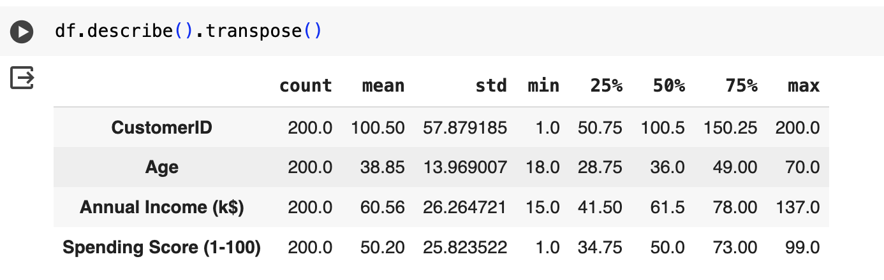
df.info(), df.describe() and Heatmap
The min Spending Score is 1 and max is 99 which means we don't have 100 score spenders in our data.
for all the features, the mean is greater than standard deviation
High variability

Slide 4
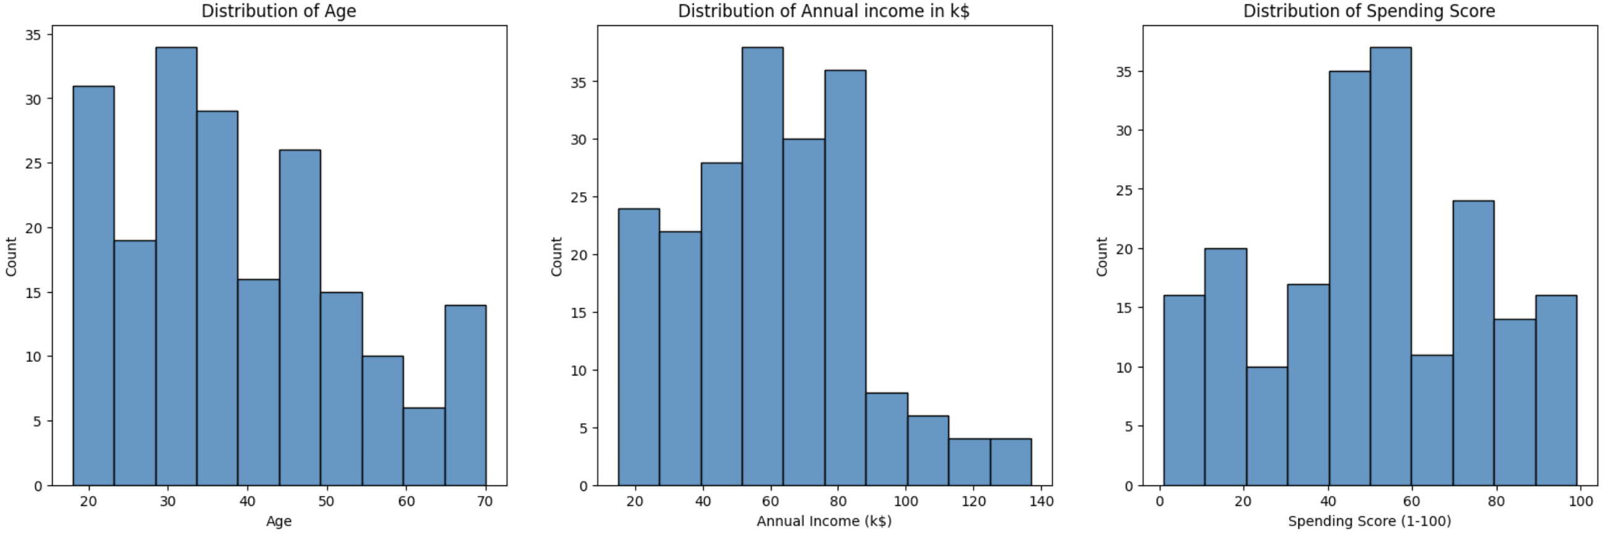
Distribution of Age, Annual Income, and Spending Score
Most of the customer's age are between 35 - 45
Most of the annual income falls between 50k to 85k
The maximum spending score is in the range of 40 to 60

Slide 5
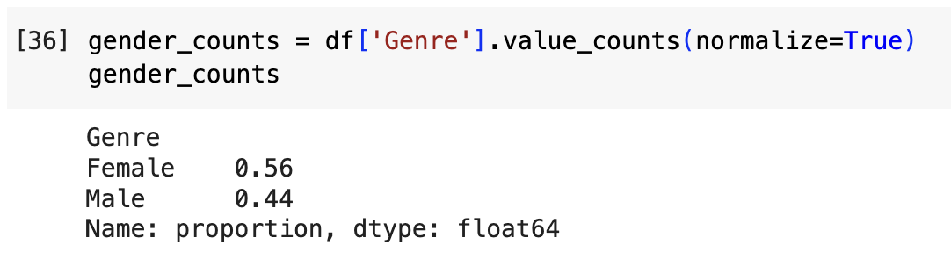
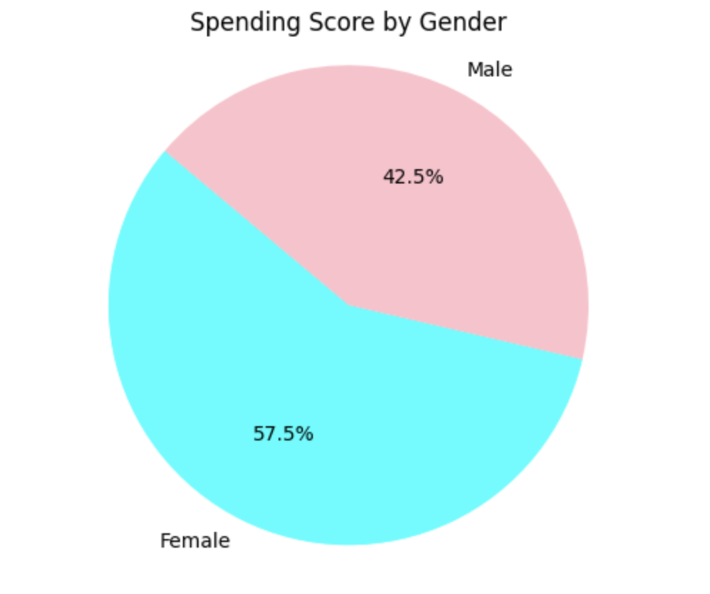
Gender Analysis
More female (56%) customers than male (44%) customers.

Slide 6
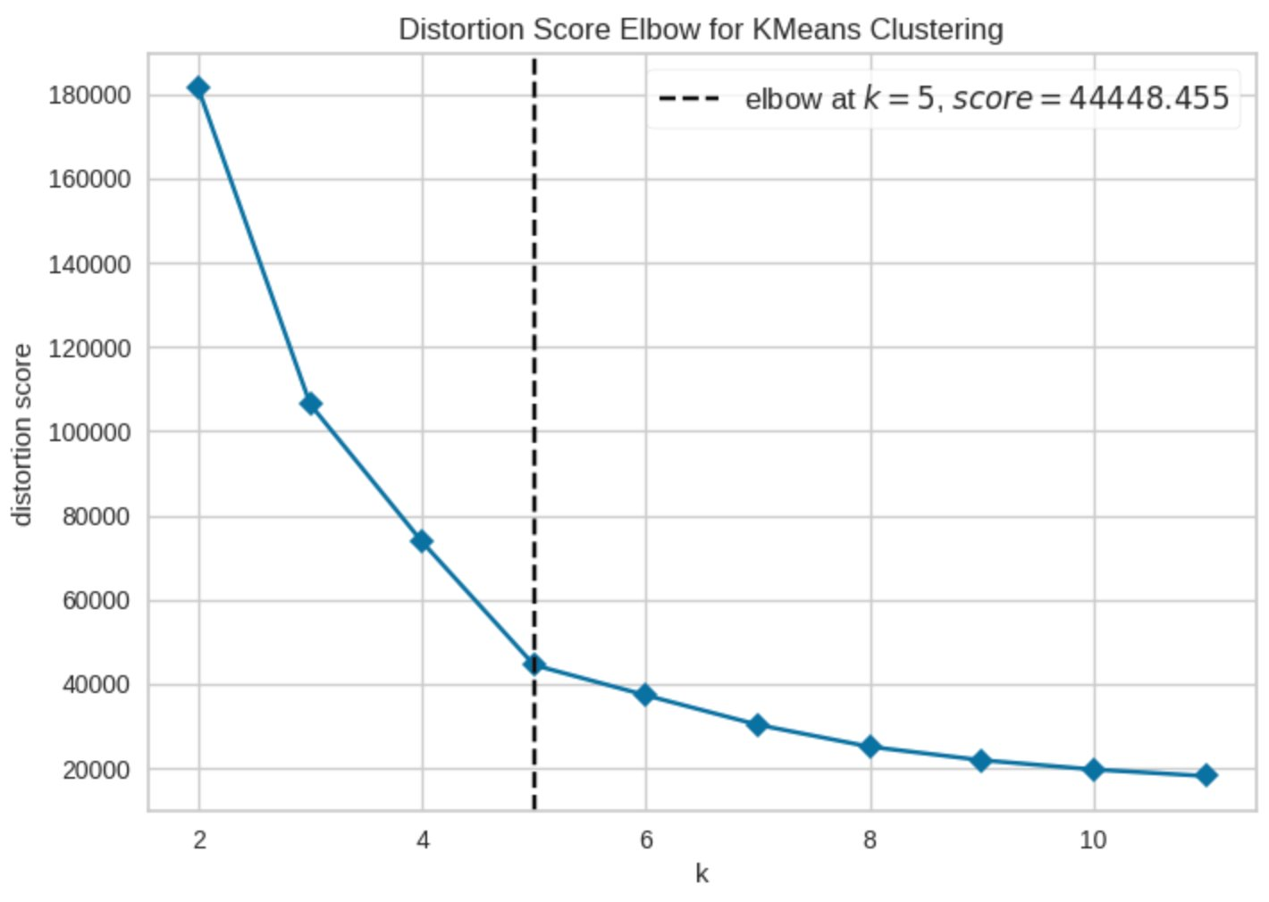
K value
Determine optimal no. of clusters using Elbow Method

Slide 7
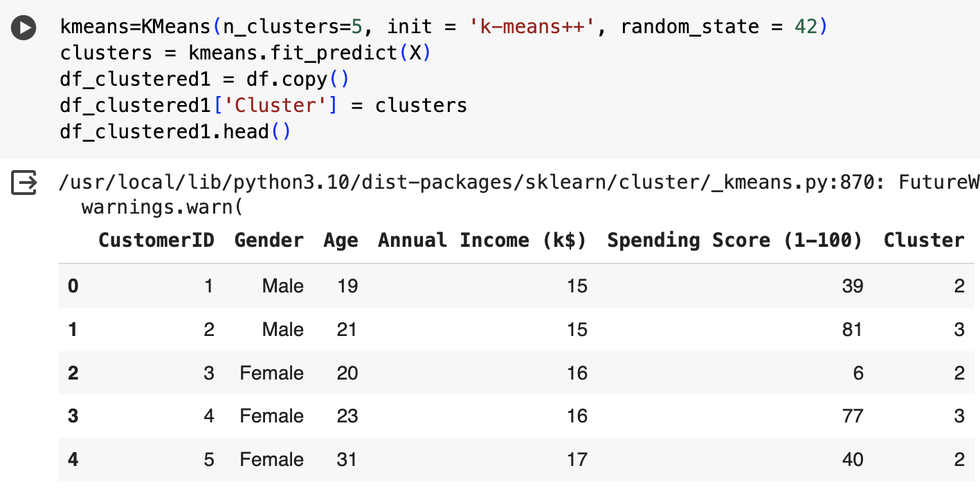
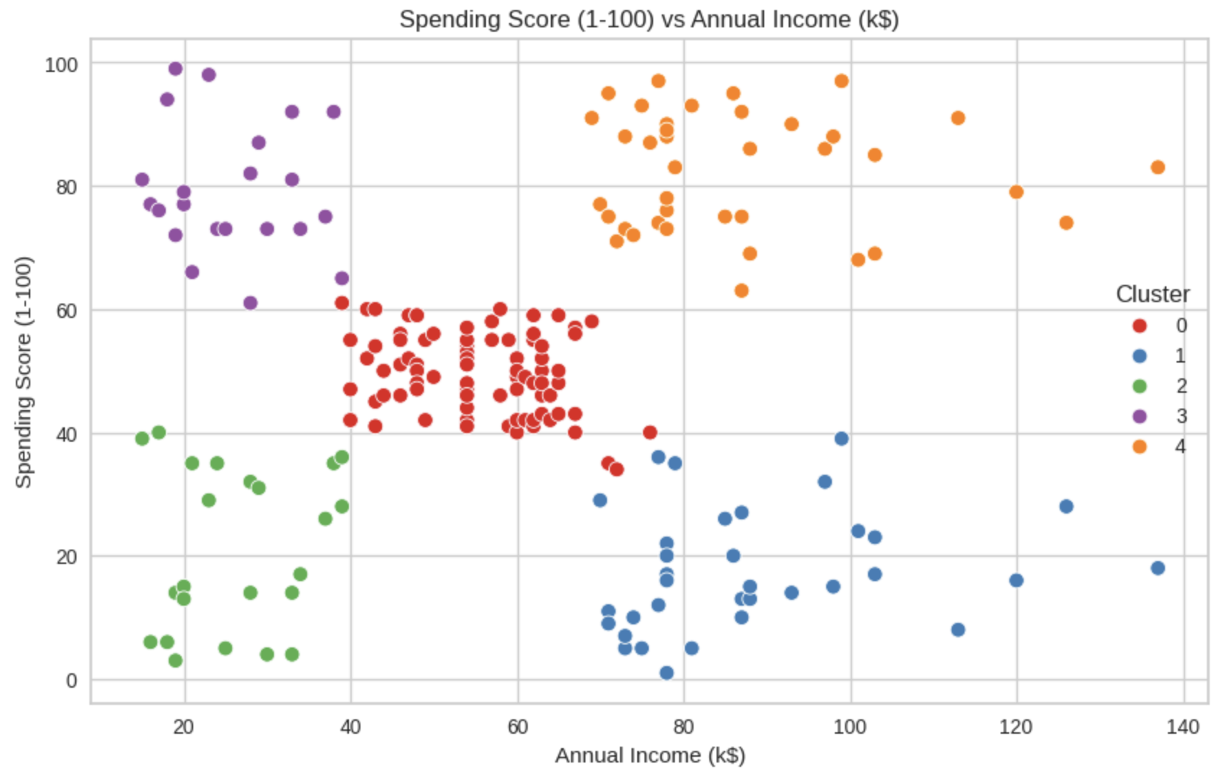
K-Means Clustering
Maximum no. of customers -> Cluster - 0 with annual income 41k - 70k and their spending scores are between 42 and 62.
Minimum no. of customers -> Cluster - 2 with annual income between 15k and 40k and spending score in between 10 and 41

Slide 8
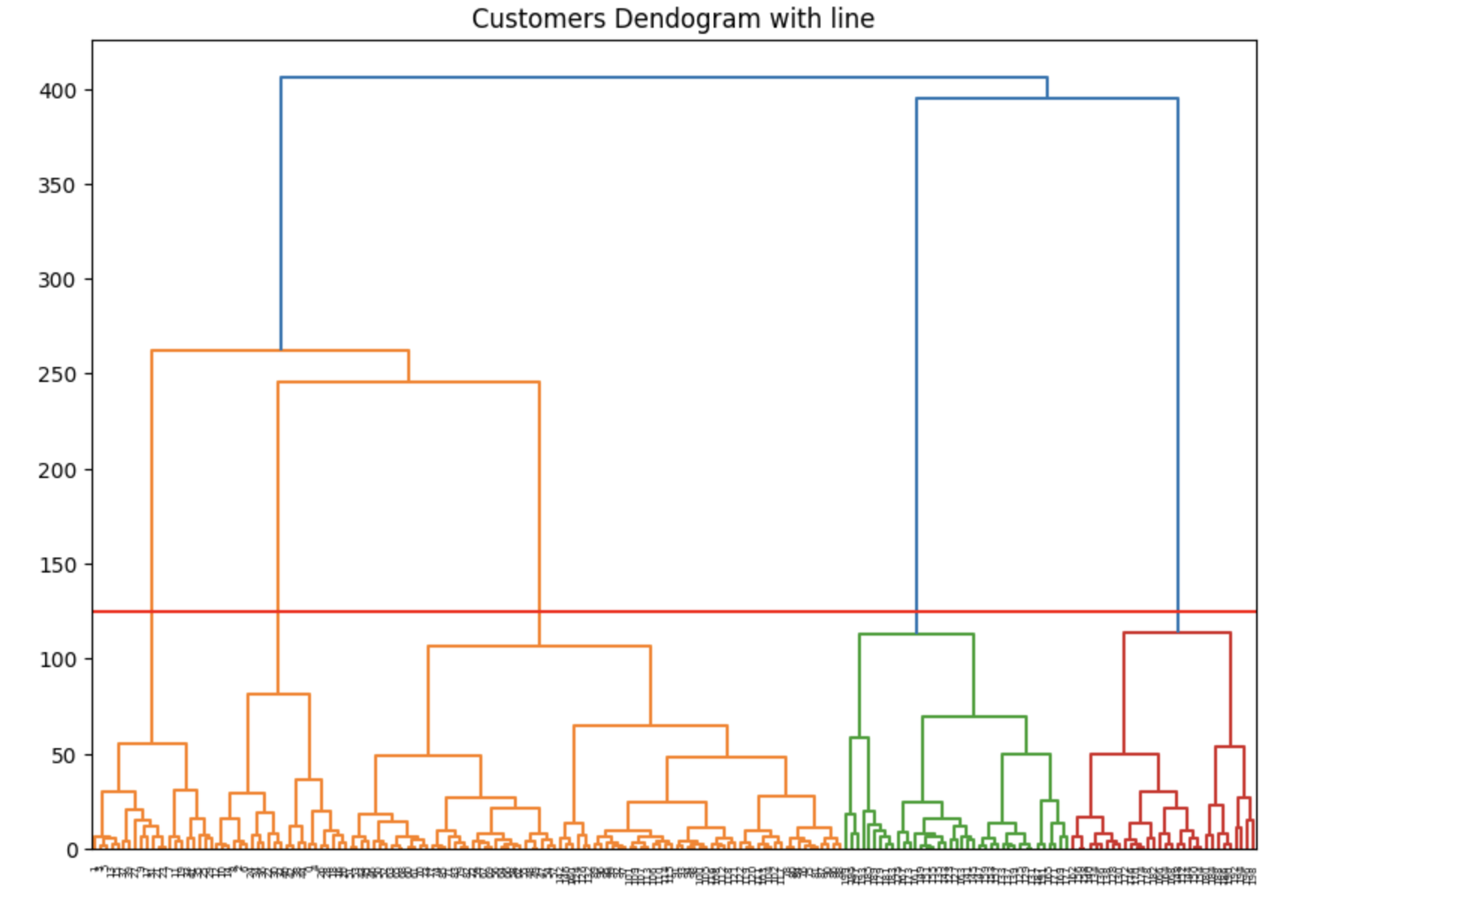
Hierarchical Clustering
Hierarchical clustering starts with all your data points in separate groups, then it gradually merges the most similar groups together, step-by-step, until everything is in one big group.
This creates a hierarchy (like a family tree) showing how similar the data points are in each cluster.

Slide 9
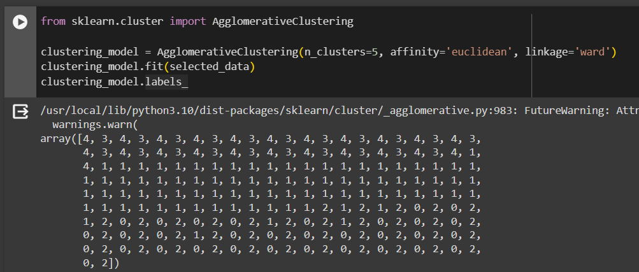
Hierarchical Clustering
We're using the Agglomerative Clustering algorithm to categorize our data into 5 distinct groups. This process considers the distance between data points and merges them into clusters, aiming to minimize variance within each group.

Slide 10
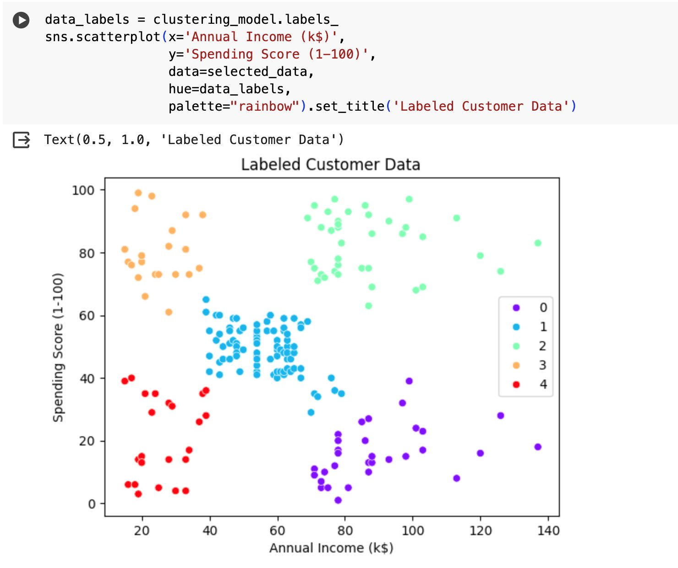
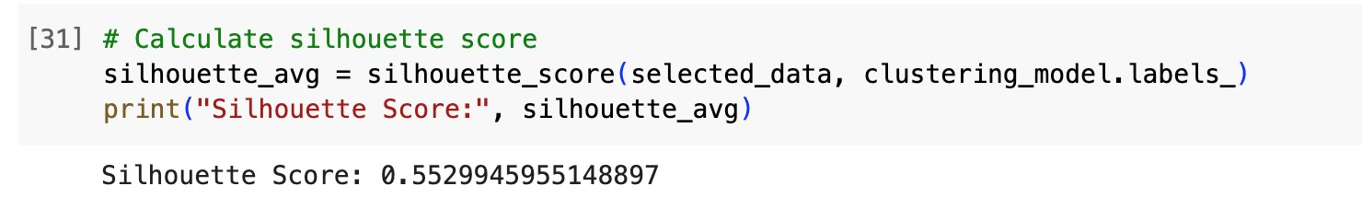

Slide 11
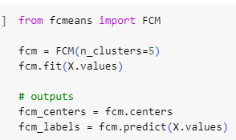
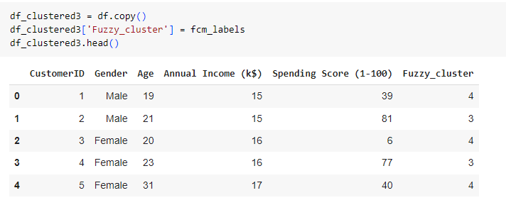
Fuzzy C Mean Clustering
A new column(Fuzzy_cluster) is add to df(dataframe) containing the cluster labels assigned by a fuzzy clustering algorithm .

Slide 12
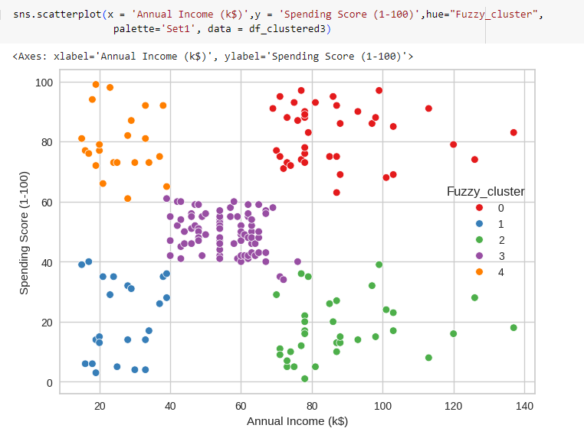
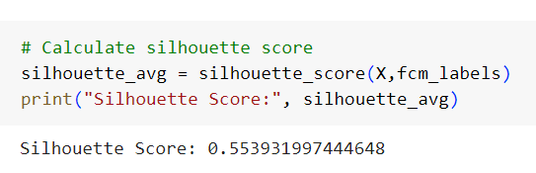
Fuzzy C Mean Clustering
Maximum no. of customers -> Cluster - 3 with annual income 41k - 78k and their spending scores are between 38 and 61.
Minimum no. of customers -> Cluster - 1 with annual income between 11k and 40k and spending score in between 11 and 40.

Slide 13
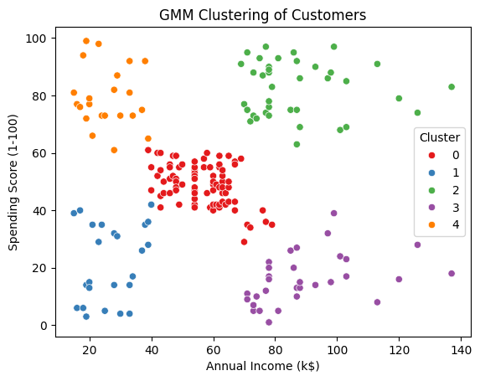
Gaussian Mixture Model
Maximum no. of customers -> Cluster - 0 with annual income 39k - 80k and their spending scores are between 35 and 65.
Minimum no. of customers -> Cluster - 2 with annual income between 10k and 40k and spending score in between 2 and 41

Slide 14
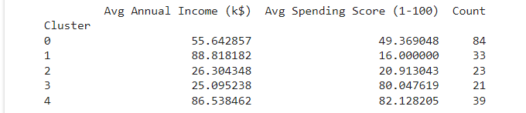
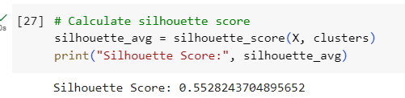
As per Cluster statistics generated, customers having moderate income are having a balanced spending score.
More no. of customers come under this category.

Slide 15
Comparision
K-Means | Hierarchical | Gaussian Mixture | FCM
0.553931997444648 | 0.5529945955148897 | 0.5528243704895652 | 0.553931997444648
Almost all the algorithms performed the same, with slight differences.

Slide 16

Thank You

